Slide 1

Content: aka.ms/mkedevdays
#Azuredevdays

Slide 2
Microsoft Cognitive Services
Frank Migacz
Cloud App Designer

Slide 3
Azure AI
AI apps & agents
Knowledge mining
Machine learning
Azure Bot Service
Azure Cognitive Services
Azure Cognitive Search
Azure Databricks
Azure Machine Learning
Azure AI infrastructure
Notes:
The Cognitive Services belong our Azure AI business. There are three main solutions you can build with Azure AI
First you can build AI apps and agents that can interact with the user naturally with pretrained AI models and bots.
Second, you can unlock insights lying latent in your content with knowledge mining.
And lastly, you can build your own AI machine learning models. – even thought some of you in this room may not develop ML models - integrate into your apps and services by deploying as APIs
Today we are going to dive specifically into AI apps and agents (Azure Cognitive Services)

Slide 4






Adding intelligence
Azure Cognitive Services
Intelligent Agents
Cognitive Services
Machine Learning
Core infrastructure
Vision
Speech
Language
Knowledge
Search
Notes:
Infuse your apps with human like intelligence with Azure Cognitive Services.
So, what are Cognitive Services? Cognitive Services are a collection of artificial intelligence APIs, and we believe in democratizing artificial intelligence. So what that means is, regardless of your skill level – (whether you're a high school student running your first program or working in industry or in a giant enterprise) -- that you should be able to use these APIs quickly - in a matter of minutes.
SDK
Regardless of your platform -- whether you're on Android or IOS or Windows, or making a website -- all of our APIs are rest APIs, which means you can call them as long as you have an Internet connection. ** There is a subset of APIs that can run in containers and on the IOT Edge. And so that's pretty huge because what we're doing is making it so that everyone can build these smarter, more context-aware applications.

Slide 5
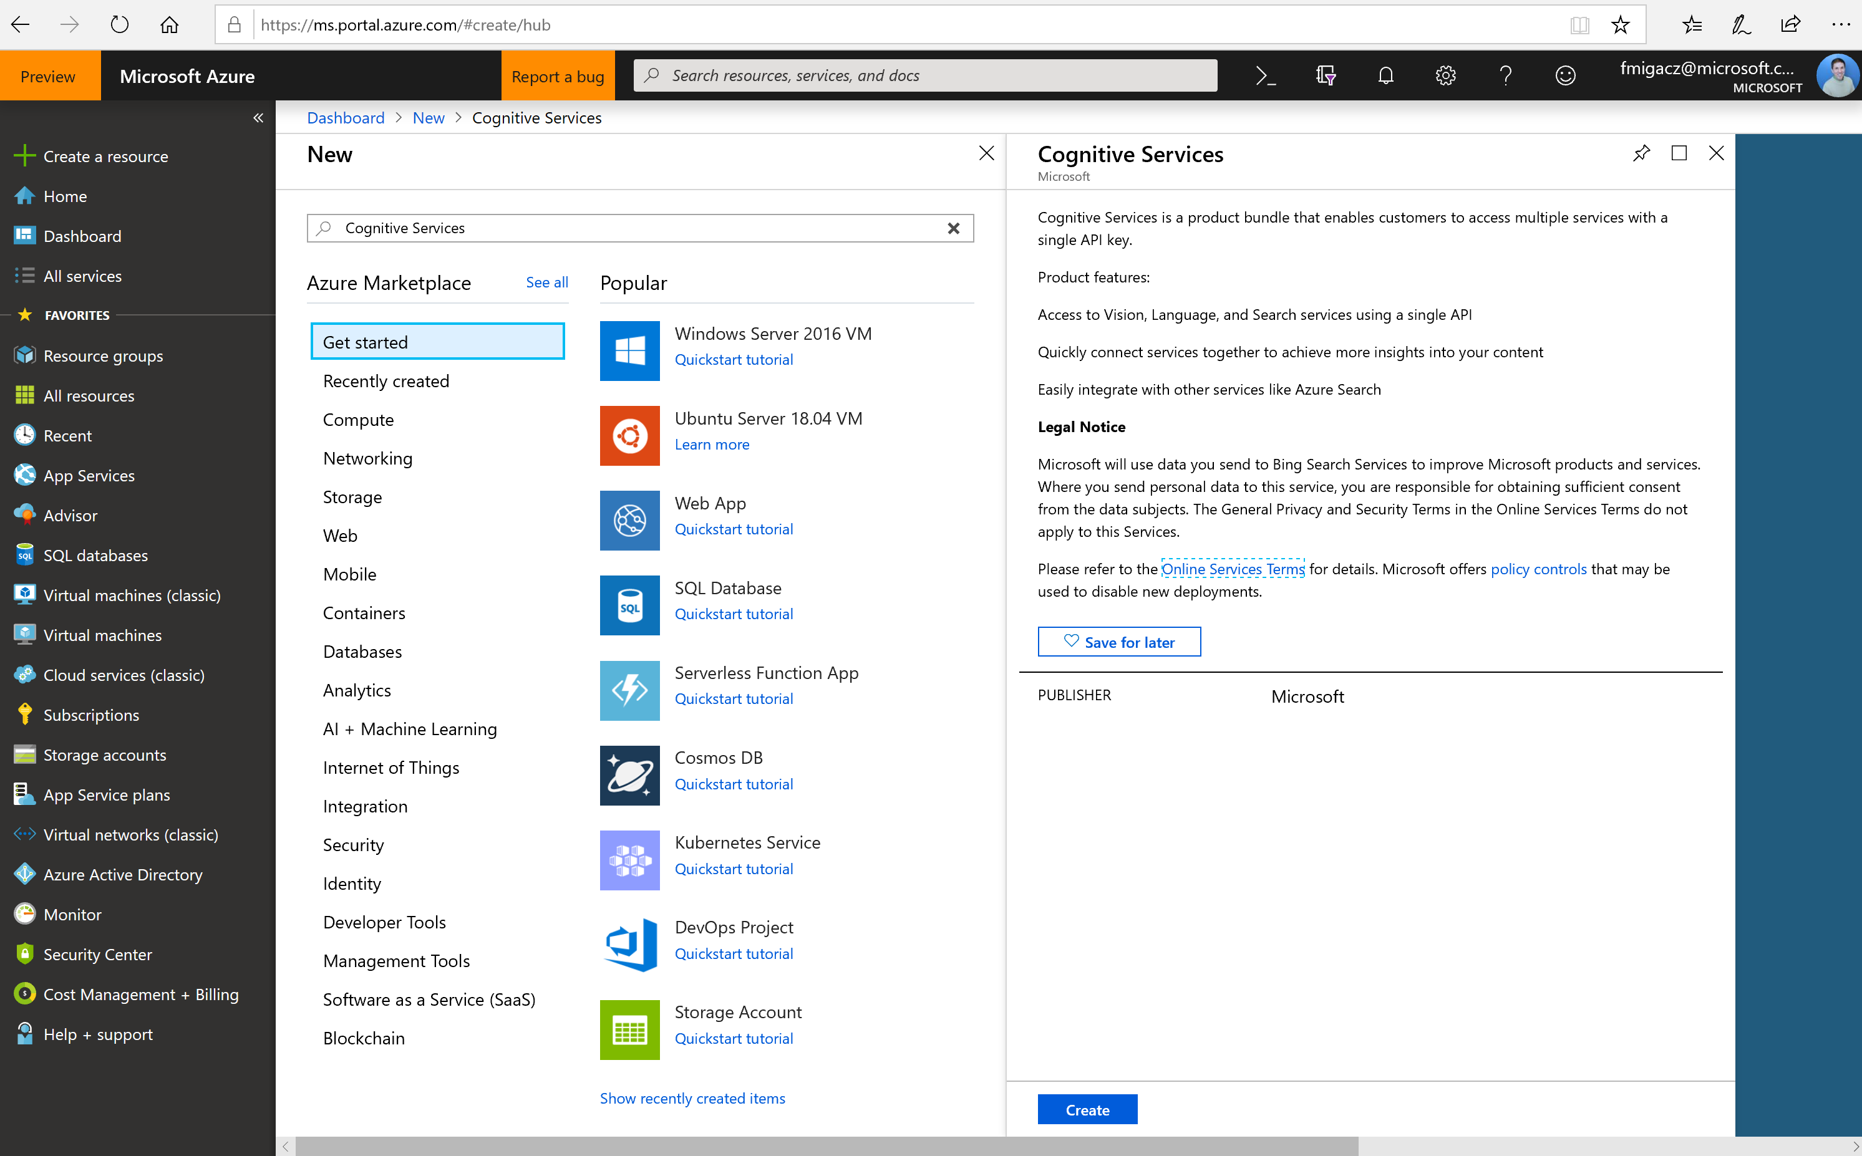
Demo
Create a service instance
Notes:
https://docs.microsoft.com/en-us/azure/cognitive-services/cognitive-services-apis-create-account

Slide 6
Building AI apps & agents
Vision
Speech
Language
Your Apps
Notes:
So what is an AI app and agent and how do you build one?
The simplest way to get started is to take your existing web and mobile application and add vision, speech, or language capabilities to them using AI models we have build.
##There are a number of customers adding AI capabilities to their apps and driving significant business impact today.

Slide 7
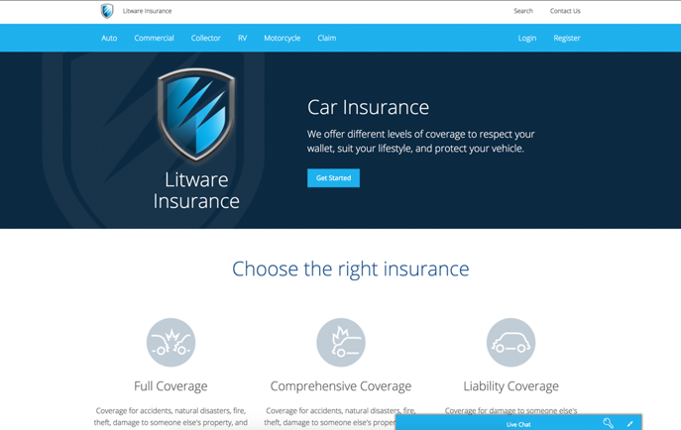
Demo
Litware Insurance Bot
Notes:
https://www.youtube.com/watch?v=DfGccsNffdQ

Slide 8


AI apps & agents: How the demo was built
Data
AI
Apps
Azure Cosmos DB
…
Azure App Service
Web & mobile apps
Vision
Speech
Language
Search
Cognitive Services
Bot Service
Azure SQL DB
CRM
Notes:
AI does not live in isolation, you need core data and app services to make this happen. Use services with Azure to store data, utilize AI, and to deploy applications.
All apps need databases. With Azure, you have two industry leading databases for both SQL and NoSQL to handle any variety of data. (Azure SQL DB and Azure Cosmos DB)
Azure Bot Service provides you an integrated environment that helps you build, connect, deploy and manage an intelligent agent to interact naturally with their users.
Give your bot the ability to see, hear, and interpret your users by seamlessly integrating Cognitive Services
In this particular scenario, the bot is surfaced as a web service, so Web Apps was used to deploy the application.

Slide 9

Demo
Custom REST calls
Notes:
Text Analytics: https://docs.microsoft.com/en-us/azure/cognitive-services/text-analytics/how-tos/text-analytics-how-to-call-api
Translator Text: https://docs.microsoft.com/en-us/azure/cognitive-services/translator/reference/v3-0-translate?tabs=curl
Cognitive Search: https://www.ailab.microsoft.com/experiments

Slide 10
Developer resources
Pricing
https://azure.microsoft.com/en-us/pricing/details/cognitive-services/
Documentation
https://docs.microsoft.com/en-us/azure/#pivot=products&panel=cognitive
Client SDKs
https://azure.microsoft.com/en-us/resources/samples/?sort=0&term=cognitive+services https://github.com/southwood/project-oxford-python
Example Code
https://github.com/jsturtevant/happy-image-tester-django
https://github.com/Microsoft/Cognitive-Face-Android https://github.com/Microsoft/Cognitive-Samples-IntelligentKiosk
Join Our Community
https://stackoverflow.com/questions/tagged/microsoft-cognitive
https://cognitive.uservoice.com/
Notes:
Access to strong documentation, sample code and community resources is critical for developers to be able to understand and become users of Cognitive Services. Customize these links based on your own resources or use the ones listed here.

Slide 11
Q&A

